Slide 1

House Price Prediction
Shashwat Shukla

Slide 2
ACKNOWLEDGMENT
In this house price prediction project, I got all the document from Flip Robo related to the dataset. The document contains all the information of column and their values. However, I have all the details I took some help from google and some trending website for data science. The dataset is dedicated to the real state, most of features has known values, that will make it easy to understand and building model.

Slide 3
INTRODUCTION
Business Problem Framing
House price predication is a real-world business problem. Every country has their own challenge to decide the house price. If we can build some model which can easily predict the price of house with some inputs then it would be very easy to understand customer intention toward the pricing. It will also help the builders and contractions company to make their project according to the customers inputs.
Conceptual Background of the Domain Problem
The house price predication project directly linked to the real-estate sales or I can say sales domain. The real-estate market is too big all over the world, it is increasing gradually day by day.
Review of Literature
House price predication project has approx. 80 columns I found that many of column’s dose not has more trend with target. The columns are fencing, kitchen quality, garage quality, electrical quality, these column dose not putting good impact on the pricing but column with overall quality, material, area of the house, location, build type, these has strong impact on the pricing of the house. So, we can also leave these columns but some customer or I can say some people also take these columns in consideration at the time of buying their house.

Slide 4
Analytical Problem Framing
Mathematical/ Analytical Modelling of the Problem
The dataset has too many null values, I can say approx. 60 – 70% column has null values. The dataset has both type of values categorical and continuous. As the dataset has both type of values, it means the null values are accordingly. I tried to fill these value that the filled values dose not mis lead the model accuracy. I use Simple Imputer for filling the null values.
These are many columns which has co-relation with each other but I keep these columns for model building because these columns putting different impact on the pricing. In this dataset, I cannot drop any column behalf of assumption because the buyer of the house has different mindset and I cannot predict which feature is important to them that is the reason I did not drop any feature expect those features which has null values more then 80%.

Slide 5
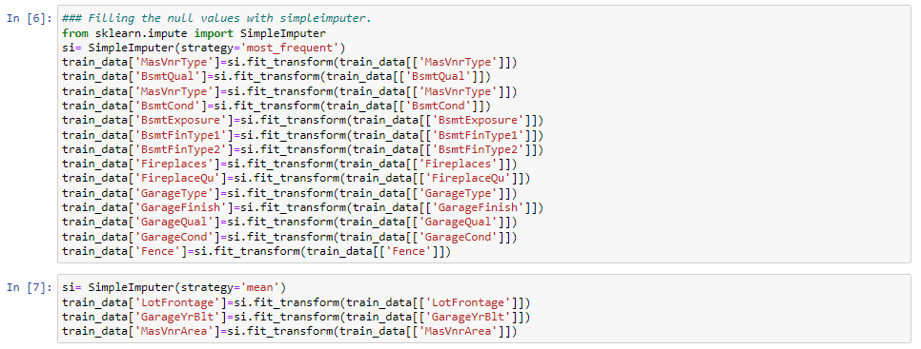
Data Sources and their formats
I got the dataset from Flip Robo. The company might get these data from some real-state company, the dataset has less row or I can say the dataset is small in terms of values and very large in term of features. I visualize all the feature as count plot but cannot paste here because the number of columns is very big but I will show all the column in scatter plotting with description.
Data Pre-processing Done
I used many the data cleaning step in this dataset for filling the missing values and changing the categorical value to integer. The screen-shot is pasted below –
Simple Imputer

Slide 6
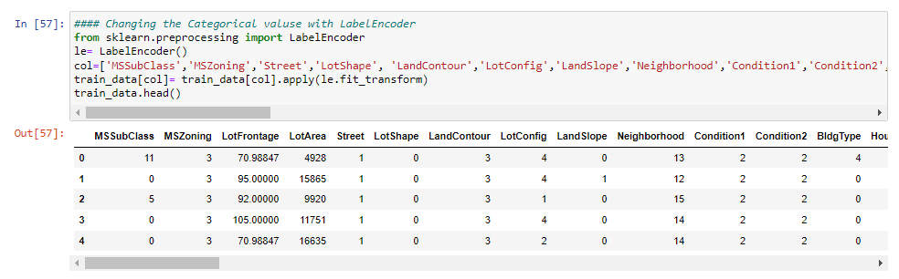
Label Encoder
Data Inputs- Logic- Output Relationships
There is total 75 input feature for this dataset, all the feature has some relation with target (output), some features are strongly associated with the output and some feature has little impact on the output.
Feature with maximum relation with target – OverallQual (78%)
Feature with minimum relation with target – BsmtQual (-62%)

Slide 7
Assumptions
I made some assumption that some outliers will be possible because as the dataset is all about house price predication. So, I did not remove any outliers.
Hardware and Software Requirements and Tools Used
I used using Dell industrial category laptop with below configuration –
1-Processor- i5
2- Ram -4 GB
3- Windows – Windows 10
But I don’t think this configuration is enough to work on that much big dataset because it will take lots of time to learn and give result. So, I think I have to use more powerful configured system.

Slide 8
Model/s Development and Evaluation
Identification of possible problem-solving approaches (methods)
The house price predication project has 80 columns and every column has their own impact on the target. So, I kept all the columns expect those which has missing values more than 80%. I assume that in this category dataset should have outliers, I did not remove any outliers.
Testing of Identified Approaches (Algorithms)
I Choose 6 model type to predict the either the customer will get micro credit loan or not. These models mentioned below –
Logistic Regression
RandomForestClassifier
GaussianNB
SVR
KNeighborsClassifier
GradientBoostingClassifier

Slide 9
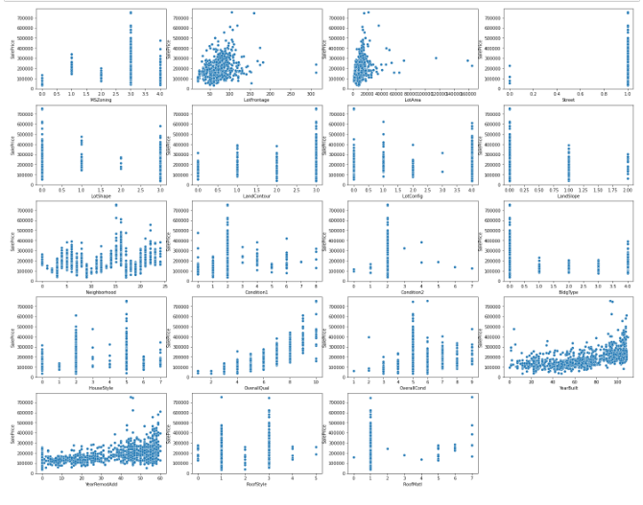
Visualizations
Scatter Plot
The dataset has 75 feature. It was not possible for me to show feature and target relation in single plot. So, separated scatter plot in 4 parts.

Slide 10
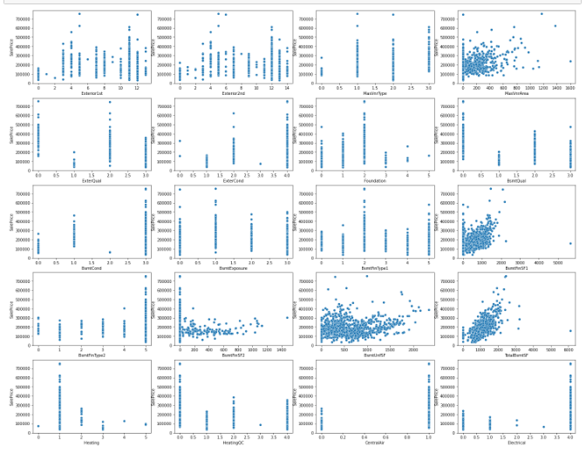

Slide 11
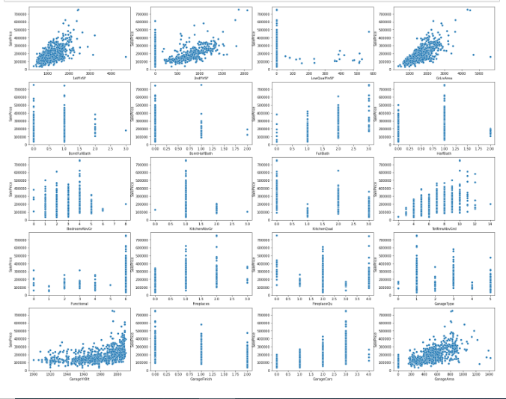

Slide 12
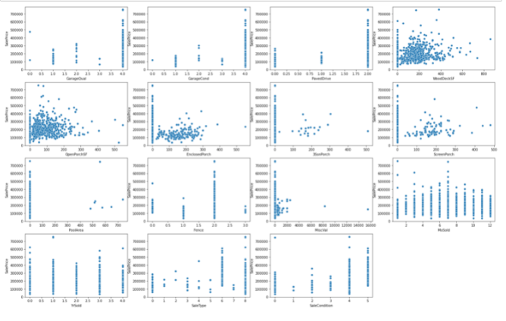

Slide 13
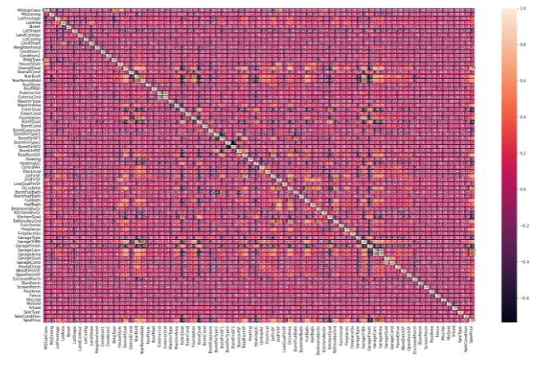
HeatMap
Conclusion - Many feature has Multicolinearity with each other but not more than 90%. I can drop some feature but cannot do this because every feature has different impact to the target which is Sales Price.
Feature with maximum relation with target – OverallQual (78%)
Feature with minimum relation with target – BsmtQual (-62%)
There are many columns which has to each other but not more than 90% and also every feature has unique relation with target which is Sale Price. So, I will proceed with all columns.

Slide 14
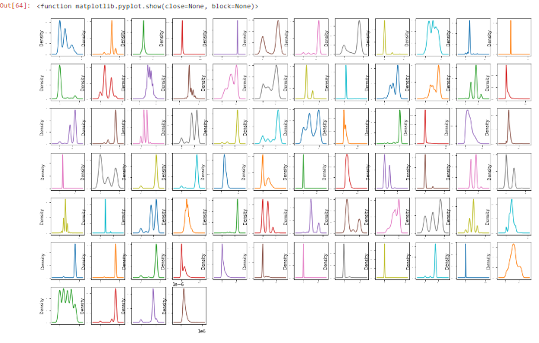
Density Plot
Most of the value is categorical values but some feature has continuous value and these show normal distribution with some skewness. I will check skewness and deal with skewness accordingly.

Slide 15
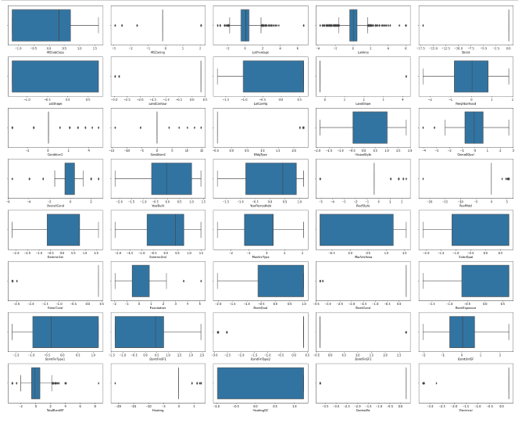
Box Plot

Slide 16
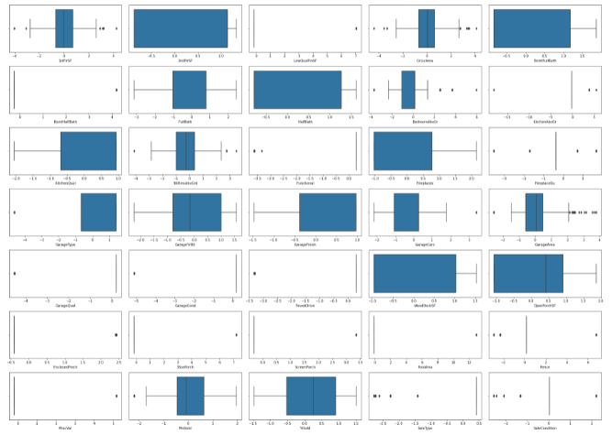
Most of the feature has categorical values, those columns which has continuous values has some outliers. These features are - Garagearea, Glrarea and 1stFr. As the most of the column do not has outliers. So, I am not going to remove any outlier as I already have small dataset in terms of rows.

Slide 17
Interpretation of the Result
I performed 6 model prediction Model Accuracy and r2 scores, cross validation and errors are mentioned below -
Accuracy scores and cross validation scores for LinearRegression model 77.14 and cross validation scores is 75.25
Accuracy scores cross validation scores for GradientBoostingRegressor model 87.76 and cross validation scores is 86.54
Accuracy scores cross validation scores for RandomForestRegressor model 85.04 and cross validation scores is 84.53
Accuracy scores cross validation scores for BayesianRidge model 77.44 and cross validation scores is 76.82
Accuracy scores cross validation scores for KNeighborsRegressor model 69.68 and cross validation scores is 73.52
Accuracy scores cross validation scores for SupportVectorRegressor model -4.66 and cross validation scores is -6.175
From the above, I conclude that GradientBoostingRegressor is giving good result as compared to other 6 model and RandomForestRegressor is also performing very good. I am going forward with GradientBoostingRegressor.

Slide 18
Conclusion
Key Findings and Conclusions of the Study
Real-estate category is so big there is lot of choice available, the result is price is depended on lots of factor but I found that 70% pricing depend on the size of house and 10% pricing depend on built type, rest 20% pricing depend on rest of the feature like kitchen, garage, fencing, electrical and etc.
Learning Outcomes of the Study in respect of Data Science
In the prospect of data science, the outcome I got from this project is to handle the dataset which has more feature is challenge to analysis the data. So, the easy way to analyse the dataset is break the columns in part then start cleaning and further process. The dataset with large columns has their challenge in every face of model building.
Limitations of this work and Scope for Future Work
I think there is no limitation with this project but if we can concise the feature of the dataset then it will be little easy to understand the dataset easily. The large dataset also has their benefits to test model large data which make the model more confident.
If the dataset also has a smaller number of null then this will also help in increasing the accuracy of the model.
The house price prediction also has good exposure in the future because this is real world problem and gradually this industry is increasing. Though I can say this project has good future.

Slide 19
Thank You

